Slide 1
Getting Started Screening and Interviewing
4491-02 Screening and Interviewing v11.0 VO.pptx
Notes:
1

Slide 2
IRS Policy
IRS policy mandates the use of the Intake/Interview & Quality Review Sheet Form 13614-C by volunteers for intake and quality review

Slide 3
Form 13614-C Intake/Interview & Quality Review Sheet
Section A (3 pages) – Completed by Taxpayer
Part I – Personal Information
Part II – Marital Status and Dependent Info
Part III – Income Questions
Part IV – Expense Questions
Part V – Life Events
Questions Re
Presidential Election Campaign Fund
Language Spoken and Any Disabled in Home
Processing of Refunds or Balance Due
Section B – Completed by Certified Volunteer
Info About Dependents, if Any
Section C – Completed by Certified Quality Reviewer
Quality Review Check List

Slide 4
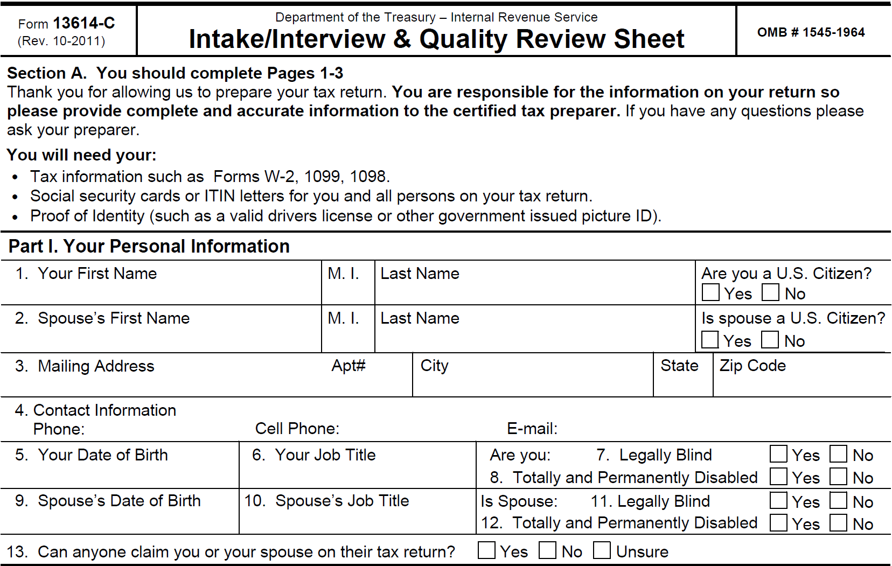
Part I. Your Personal Information

Slide 5
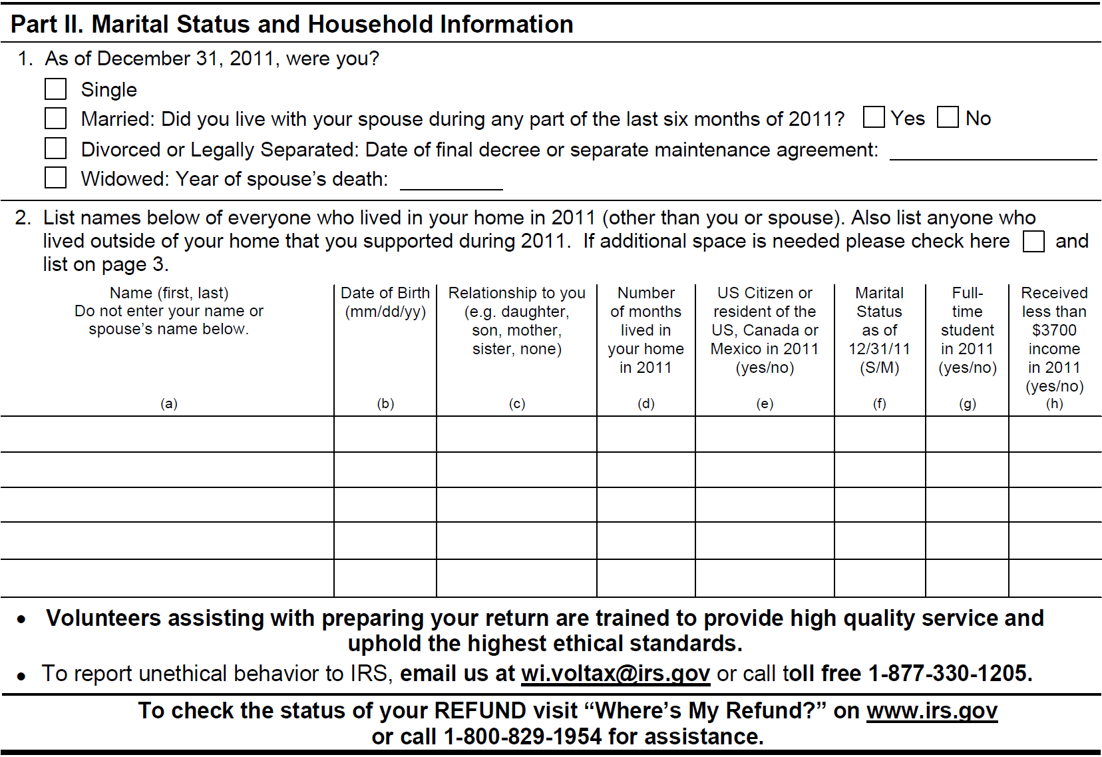
Part II. Marital Status and Household Information

Slide 6
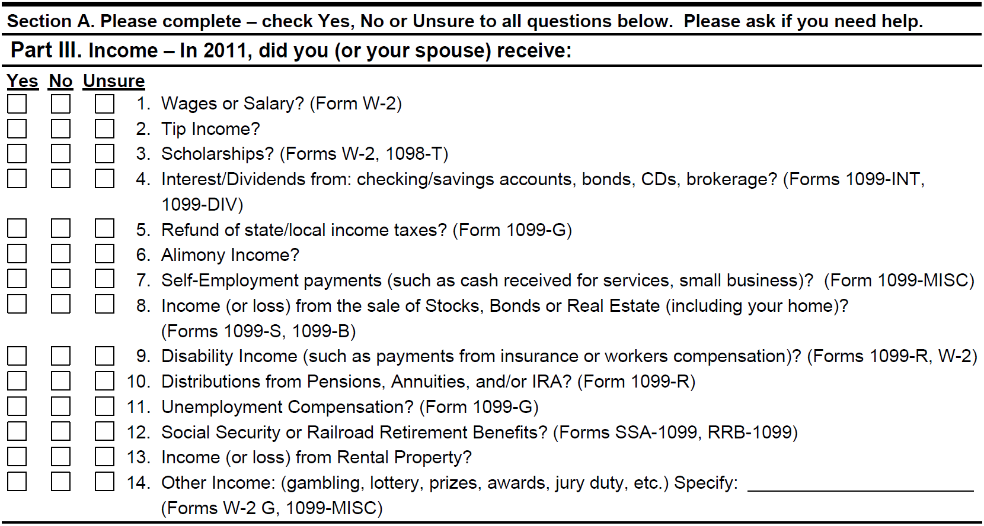
Part III. Income

Slide 7
Part IV. Expenses

Slide 8
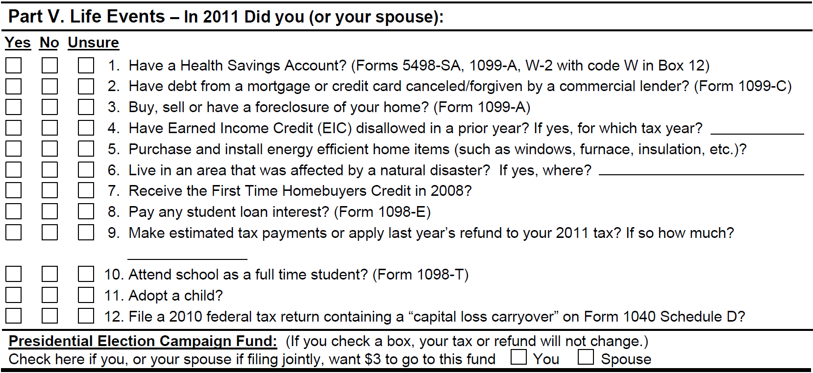
Part V. Life Events (and Presidential Election Campaign Fund)

Slide 9
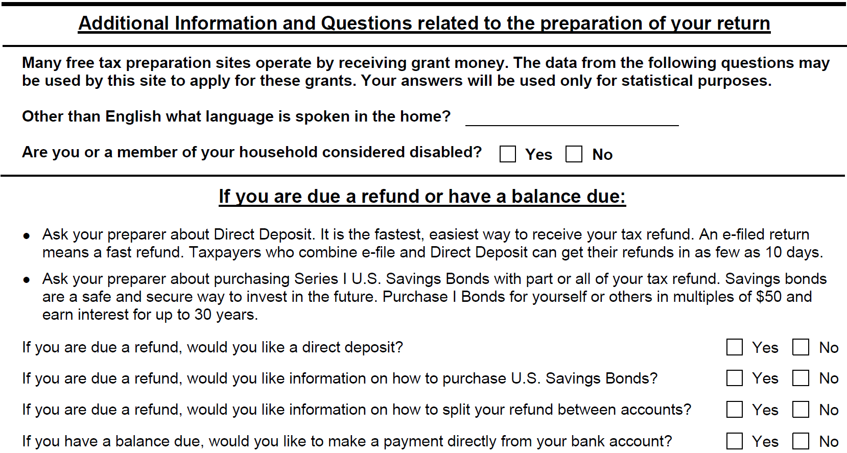
Additional Information and Questions If you are due a refund or have a balance due

Slide 10
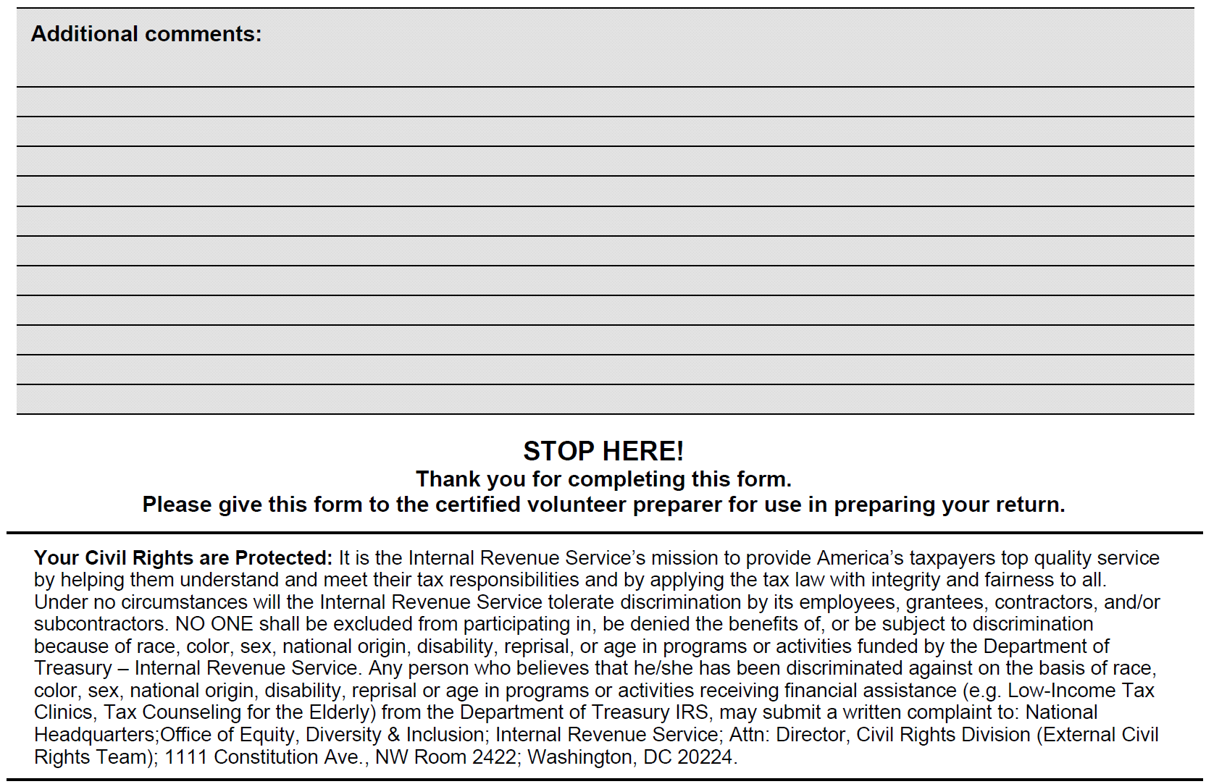
Additional comments

Slide 11
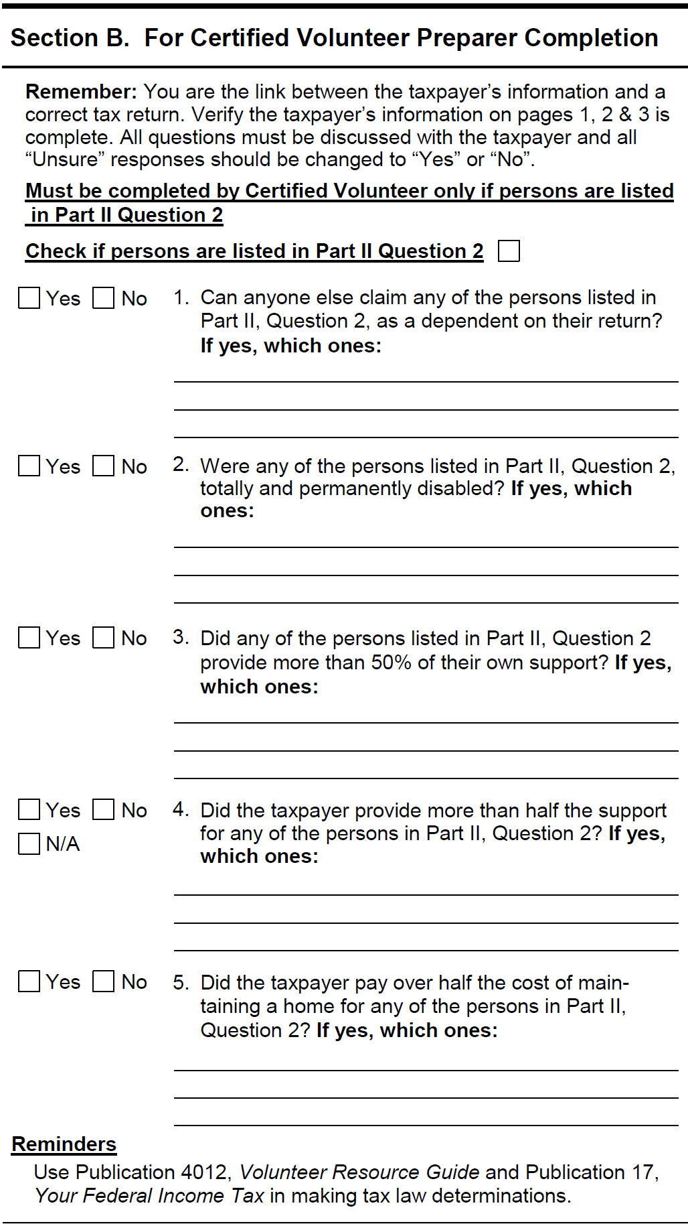
Section B. Dependent Questions

Slide 12
Section C. Quality Reviewer

Slide 13
Additional Tax Preparer Notes

Slide 14
First Steps
Review and organize TP documents and compare to intake form
Determine if return is in scope
Determine if return must be paper filed (e.g. prior year or amended)
Determine if return can be e-filed
Explain e-filing process + benefits to TP
(Some of the above may be performed by certified Greeter/Facilitator)

Slide 15
Types Of Returns Can/Can’t Prepare
Prepare those returns for which you have been trained and certified and which do not appear on the NJ “Cannot Do” List
Refer taxpayer to site coordinator or paid preparer if return is “outside your scope”
Do not prepare a tax return when you suspect it is untruthful

Slide 16
What Can’t Be e-filed
Too much withholding (more than 50% of TP income, per W-2 or 1099-R)
No valid SSN or ITIN
Spouse cannot sign Form 8879
Amended Returns (1040X) and Prior Year Returns
Can be prepared using TaxWise
Must be mailed to IRS – Cannot be e-filed

Slide 17
E-filing Benefits for TP
Return preparation more accurate
Calculations done by TaxWise
No re-entry of data for state return
Faster/more accurate processing by IRS and state
No IRS data entry required
Usually submitted same day
Usually acknowledged within 48 hrs
Direct deposit of refunds within 3 weeks

Slide 18
Respond to TP Concerns
Process is secure - IRS/State acknowledge acceptance of return to ERO
TP may file early, delay payment until April 15th (April 17th for TY2011)

Slide 19
Interviewing – The Key To A Good Return
Focus on interviewing throughout data gathering process
Review prior year return for items such as loss carry forward, last years income and deductions and refund applied to this years taxes
TaxWise software alone is not enough
Use Volunteer Reference Guide (IRS Pub 4012) decision trees and flow charts
Homework: look at every page of Pub 4012 and put tabs on pages you will want to find quickly

Slide 20
Social Security Number (SSN)
Name/SSN must match SSA database
If no SSN, TP uses SS-5 to apply (takes 6 weeks to process)
Use appropriate verification documents to prevent processing delays or rejects
Social security card
SSA 1099 benefit statement
SSA letter showing both SSN and name

Slide 21
Individual TP ID Number (ITIN)
Certain resident and non-resident aliens may not be eligible for a Social Security Number
Need ITIN for federal Tax Reporting
If TP has ITIN, Social Security Number on W-2 is probably not valid, but SSN from W-2 must be entered into TaxWise W-2 worksheet (new field in TY2011).
Verify original copy of ITIN card or letter
Taxpayer is not eligible for Earned Income Credit (EIC)
ITIN return can be e-filed

Slide 22
Maintaining Taxpayer’s Trust
Do not disclose personal tax info
Do not openly discuss taxpayers by name in the presence of other taxpayers or volunteers
Do not retain taxpayer data for follow-up visit or for subsequent preparation of return
Review return with taxpayer

Slide 23
Quality Review
When the tax return has been completed in TaxWise, another certified counselor (second pair of eyes) performs a quality review.
QR counselor continues probing while completing Section C of the IRS Interview/Intake Form

